Slide 1
Curated List App

Slide 2
What it is about ?
It’s a web app which lets you make a collection of resources and share with others users of app
I got the inspiration from the seeing wonderful resources curated as GitHub repo. I took this idea and I wanted to make a web app where these resources will be bit more organized
This app uses password less authentication to sign in. you can sign in with email so no worrying of remembering another account password and is secure as well

Slide 3
Tech Used And Why It was Chosen
This project is build with Next JS (React JS Framework) which can handle frontend and react as well as enable us to do API work using Next JS API routes.
Next JS provides better SEO because it use different rendering techniques than simple create react app
it provides more control on how you want to build your app you want to render on server on created static pages or kind of hybrid. It is extremely fast
Image take lot of bandwidth. Next JS comes with image optimization which is very useful for websites with media content
I knew React and Redux and wanted to expand that knowledge path to next step

Slide 4
What I learned
Building this project I learned bit more about how server side rendering works and how it can be more useful and more SEO friendly
I learned and adapted how to think different when using next JS from traditional plain react way because of server side rendering
I learned Next Auth for authentication how it made authentication job easy. Specially password less authentication

Slide 5
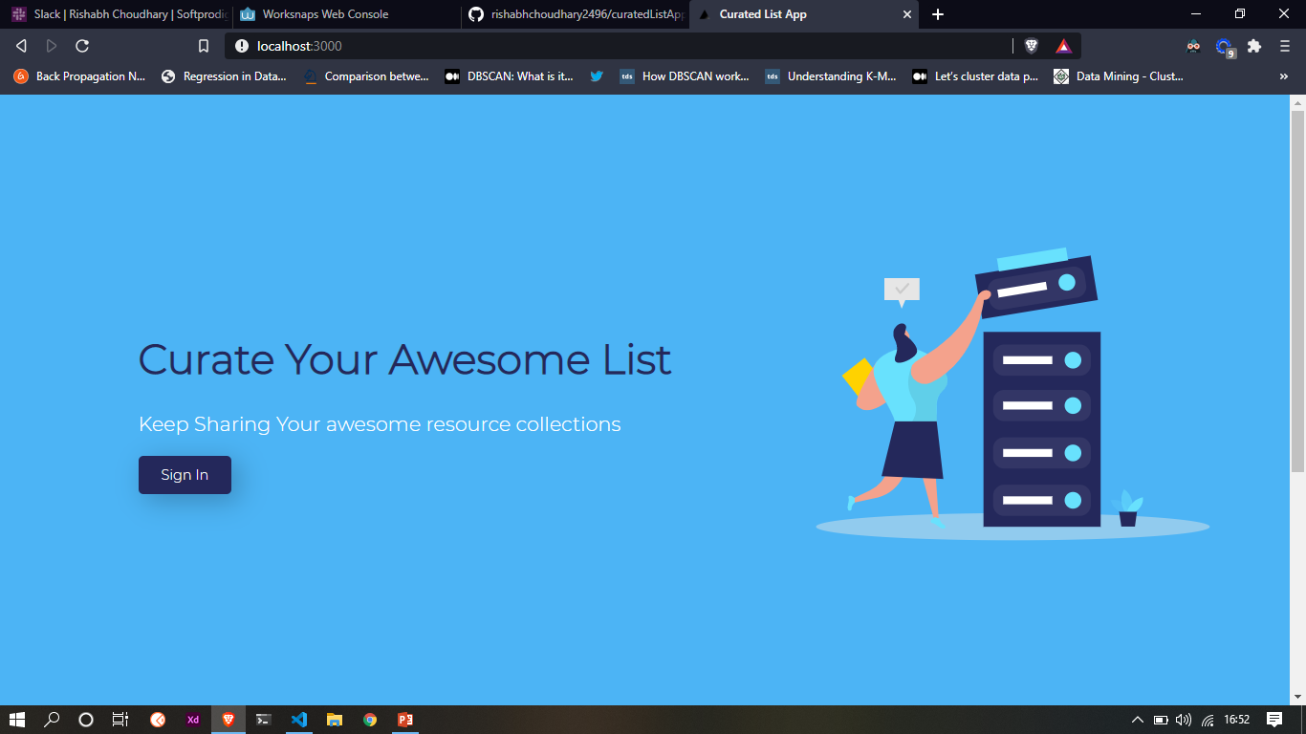
How it works
First you see a landing page where you can sign in. without sign in you can view other pages of app
Best part is you don’t need to sign and remember all those details to sign in.
when you click sign in it will ask for your email and send you a link on your
email. Where you can sign in. just like that

Slide 6
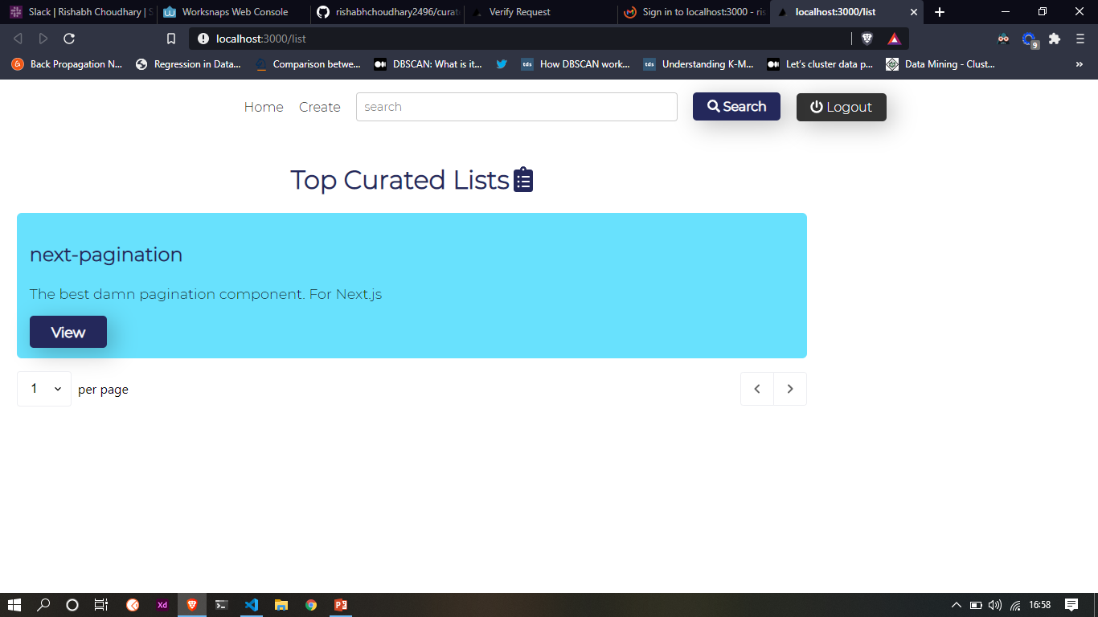
After sign in you can see Home where there might be list posted by other users
You can also search it use autosuggest so it will try to suggest when you are typing on search
You can create your list by clicking on created link

Slide 7
Scope for Improvement
First all I would like to spend some time to make design look better in some aspects and this is not optimized for mobile screen and I would like to work on so it can be viewed on mobile
I want to show a section of top people whose resources are loved by others
in home screen based on how many give favourite their list
I would like to add Tags functionality so filtering can be easy for all kind of resources and it would be organized according to categories
Some minor things for R&D on they work on Next JS
I would like to expand more functionality on this in the future

Slide 8
Thank You

